Slide 1

Bankruptcy Prediction Analysis
Nikhil Bhalala
Joseph Larson

Slide 2

Agenda
Introduction
01
Literature Review
02
Research Questions & Methods
03
Results/Discussion & Conclusion
04

Slide 3
Introduction
The study of bankruptcy prediction has been a staple in multivariate statistical research for nearly a century.
Accurate prediction of firm bankruptcy has become increasingly important as the world economy has shifted towards globalization
The dataset utilized for our analysis is source from the Taiwan Economic Journal from the years 1999-2009
Our dependent variable is bankruptcy
We examine how simple modeling and statistical methods can still accurately determine the key factors that influence firm bankruptcy in large firms. Our aim with this analysis is not to provide the most accurate and innovative statistical analysis of bankruptcy prediction. Rather, our focus is concerned with the utilization of simple multivariate modeling and statistical methods to determine the key factors of large firm bankruptcy prediction while simultaneously shortening computation time and maximizing interpretability.

Slide 4
Literature Review
Three central bankruptcy prediction works were reviewed in orded for us gain a more holistic understanding of bankruptcy prediction
Of the three works reviewed: A Review of Bankruptcy Prediction Studies 1930-Present (Gissel, Giacomino, Akers, 2007) was most important for our study. The work was crucial in developing our understanding not only recent findings in the field of bankruptcy prediction, but also to grasp the foundations of the field. The three authors of the work successfully illustrate the comprehensive history of bankruptcy prediction studies, ranging from the 1930s to the late 2000s.

Slide 5
Central Research Question
The primary goal of our analysis relates to the determination of key factors that influence bankruptcy in large firms.

Slide 6
Methods
PCA & Logistic Regression
PCA: Principal Component Analysis was utilized in our analysis primarily due to its ability to tackle the issue of dimensionality that was prevalent in our dataset (96 numerical factors)
Logistic Regression: Logistic regression was utilized in our study due to its ability to produce comprehensive predictive analyses. More specifically, logistic regression is the appropriate analysis to conduct when the dependent variable is dichotomous.

Slide 7
Principal Component Analysis (PCA)
Principal Component Analysis applied on the company bankruptcy dataset having 93 variables and 6819 observations each possesses a company
Tests:
Cronbach's alpha : 0.02
Kaiser-Meyer-Olkin (KMO) Test for Sampling Adequacy : 0.50
Bartlett's Test of Sphericity : chi-square: 2020170.265
p-value < 2.22e-16

Slide 8
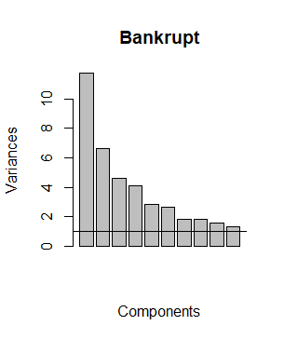
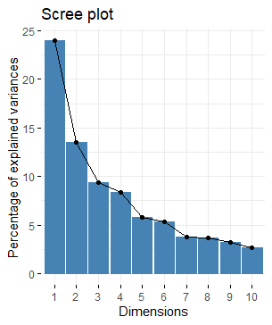
Component were determined using two techniques : Scree plot & Eigenvalues

Slide 9
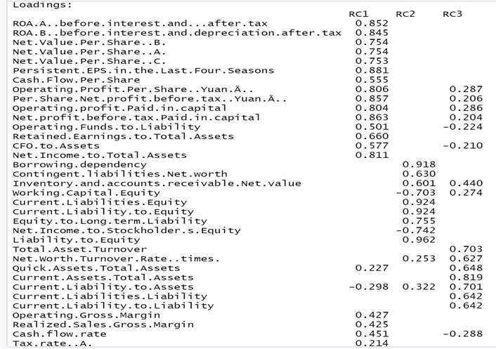
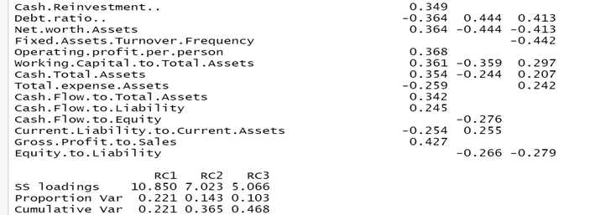
Component Matrix:
Cutoff is 0.2
Displayed matrix consisted of 3 Component.
Earnings Per Share
Inflation and Interest rate expectations
Return on Assets.

Slide 10
Principal Component Analysis Contributing Variance
 | Earnings Per Share | Inflation and Interest rate expectations | Return on Assets
loadings | 10.85 | 7.02 | 5.06
Proportion Var | 22.1% | 14.3% | 10.3%
Cumulative Var | 22.1% | 36.5% | 46.8%

Slide 11
Conclusion
Our analysis indicates that more simplistic statistical methods, PCA and logistic regression, are able to accurately predict bankruptcy in large firms. The empirical results obtained from our PCA, and logistic regression analyses suggest that the methods, despite not being nearly as complex as advanced machine learning techniques, are still able to produce acceptable prediction results. Our findings are in line with previous research involving the use of multivariate statistical analysis of bankruptcy prediction.

Slide 12
References
Burlacu, S., Gutu, C., & Matei, F. O. (2018). Globalization–pros and cons. Calitatea, 19(S1), 122-125.
FitzPatrick, P. 1932. A comparison of ratios of successful industrial enterprises with those of failed companies. The Certified Public Accountant (October): 598-605, 656-662, and 727-731, respectively.
Tsukuda, J., & Baba, S. I. (1994). Predicting Japanese corporate bankruptcy in terms of financial data using neural network. Computers & Industrial Engineering, 27(1-4), 445-448.
Bellovary, J. L., Giacomino, D. E., & Akers, M. D. (2007). A review of bankruptcy prediction studies: 1930 to present. Journal of Financial education, 1-42.
Altman, E. I. (1968). Financial ratios, discriminant analysis and the prediction of corporate bankruptcy. The journal of finance, 23(4), 589-609.
Beaver, William H. "Financial ratios as predictors of failure." Journal of accounting research (1966): 71-111.
Chen, M. Y. (2011). Bankruptcy prediction in firms with statistical and intelligent techniques and a comparison of evolutionary computation approaches. Computers & Mathematics with Applications, 62(12), 4514-4524.

